Slide 1

HOME OFFICE
Caio Cesar Volpi
Matheus da Silva Torres
Júlia Damascena

Slide 2
You usually need a computer and an Internet connection.
.
Home office is a global trend that gains more followers every year.
Basically, it's about allowing employees to work from anywhere.
Normally you need a computer and internet connection.

Slide 3
Scrum
What is Scrum?
Scrum is a tool frequently used by teams that work from home.
Scrum is a management framework that teams use to self-organize and work towards a common goal.

Slide 4
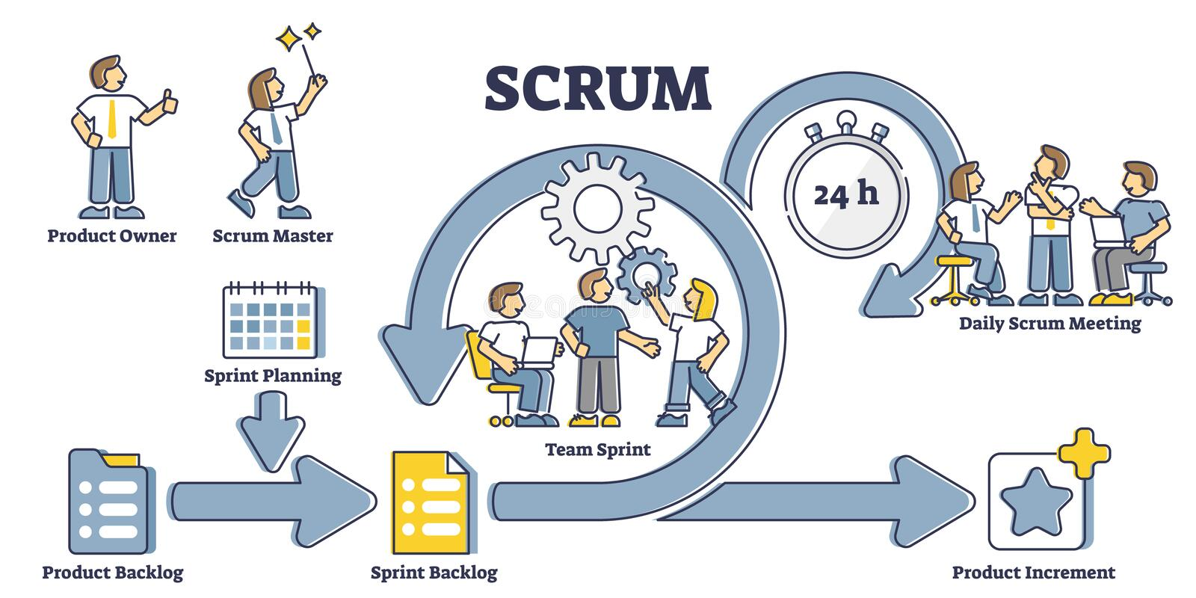
A Scrum Team needs three specific roles: a Product Owner, Scrum leader or master, and development team.

Slide 5
Trello
What is Trello?
Trello is a project management tool based on virtual boards.
Trello is used to facilitate the monitoring and management of projects, tasks and teams. It helps with collaboration, assigning responsibilities, and monitoring workflow.

Slide 6
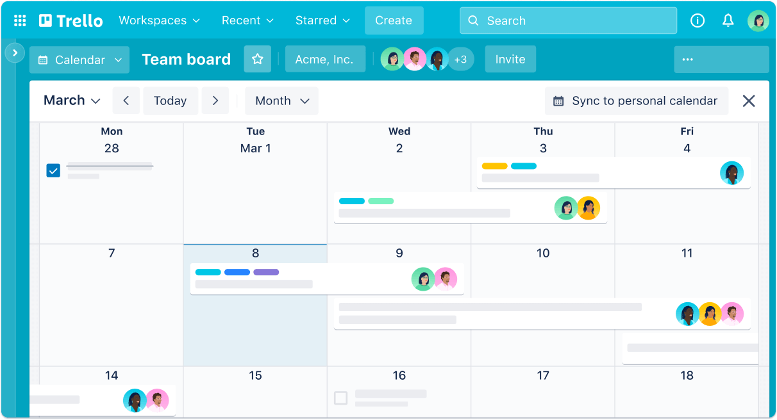
Interface Trello

Slide 7
Kanban
What is it?
Kanban is a visual method for work management, originating in Japan, initially used by Toyota in automobile production. The word "Kanban" literally means "visual card" in Japanese.
To use:
Kanban is used to visualize workflow, improve efficiency, and ensure smoother production. It provides transparency, allowing teams to clearly track work progress and quickly identify bottlenecks.

Slide 8
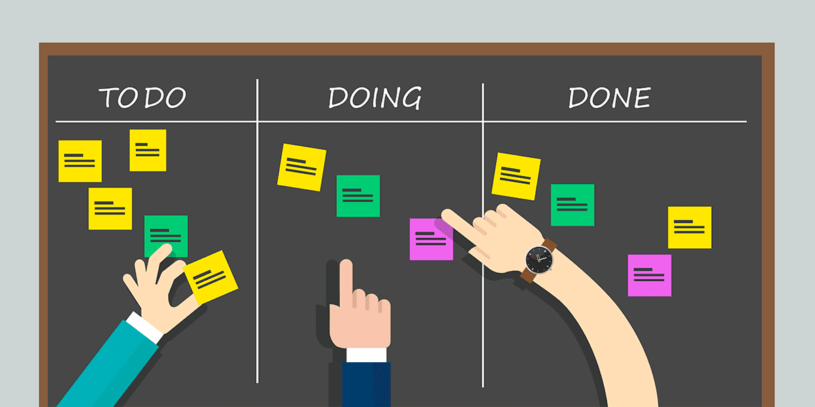
Model Kanban

